Slide 1
BOYER MOORE ALGORITHM
CSE 5211 – Analysis of Algorithm
Dr. William D Shoaff
Group:
Aleesha Mishra
Neha Sagar Khan
Vineet Palan

Slide 2
String Search Algorithm
The goal of any string-searching algorithm is to determine whether or not a match of a particular string exists within another (typically much longer) string.
Many such algorithms exist, with varying efficiencies.
String-searching algorithms are important to a number of fields, including computational biology, computer science, and mathematics.

Slide 3
Problem Statement
A prevalent issue in text editing and DNA sequence analysis is: finding string pattern inside other string. Assume we have a string S consisting of an array of characters from some alphabet ∑ where ∑ = {0,1} i.e. strings of binary digits (eg. 10101111) or ∑ = {A,B,a,b} i.e. strings of some alpha sequence (eg. AbbBBAAa). The string matching problem is that, given a string pattern P, we want to find the occurrence of P in S.
To resolve the problem, there are multiple approaches. However we have taken into account two of them; Boyer Moore and Naïve Algorithm
Boyer Moore uses three clever ideas which other string matching algorithms don’t:
The right to left scan
The bad character heuristics
Good suffix heuristics.

Slide 4
The Naïve Algorithm
The naive algorithm finds all valid shifts using a loop that checks
the condition P[1….m]=T[s+1…. s+m] for each of the n-m+1
possible values of s.(P=pattern , T=text/string , s=shift)
NAIVE-STRING-MATCHER(T,P)
n = T.length
m = P.length
for s=0 to n-m
if P[1…m]==T[s+1….s+m]
printf” Pattern occurs with shift ” s

Slide 5
The brute-force pattern matching algorithm compares the pattern P with the text T for each possible shift of P relative to T, until either
a match is found, or
all placements of the pattern have been tried
Brute-force pattern matching runs in time O(nm)

Slide 6
Naïve Time Complexity Analysis
Assume P consists of n copies of a single char and T consists of m copies of the same char:
T: aaaaaaaaaaaaaaaaaaaaaaaaa
P: haaaaa
Total number of comparisons: m(n-m+1)
Worst case time complexity : O(mn)
T: aaaaaaaaaaaaaaaaaaaaaaaaa
P: aaaaaa
Total number of comparisons: m
Best case time complexity : O(m)

Slide 7
Boyer Moore - Introduction
It is developed by Robert Boyer and J Strother Moore in 1977.
The B-M string search algorithm is a particularly efficient algorithm, and has served as a standard benchmark for string search algorithm ever since.

Slide 8
How does it work?
The B-M algorithm takes a ‘backward’ approach: the pattern string(P) is aligned with the start of the text string(T), and then it compares the characters of pattern from right to left, beginning with rightmost character.
If a character is compared that is not within the pattern, no match can be found by comparing any further characters at this position so the pattern can be shifted completely past the mismatching character.

Slide 9
Continues…
For determining the possible shifts, B-M algorithm uses 2 preprocessing strategies simultaneously. Whenever a mismatch occurs, the algorithm computes a shift using both strategies and selects the larger shift. Thus, it makes use of the most efficient strategy for each individual case.
The 2 strategies are called heuristics of B-M as they are used to reduce the search. They are:
1. Bad Character Heuristic
2. Good suffix Heuristic

Slide 10
Detailed Example

Slide 11
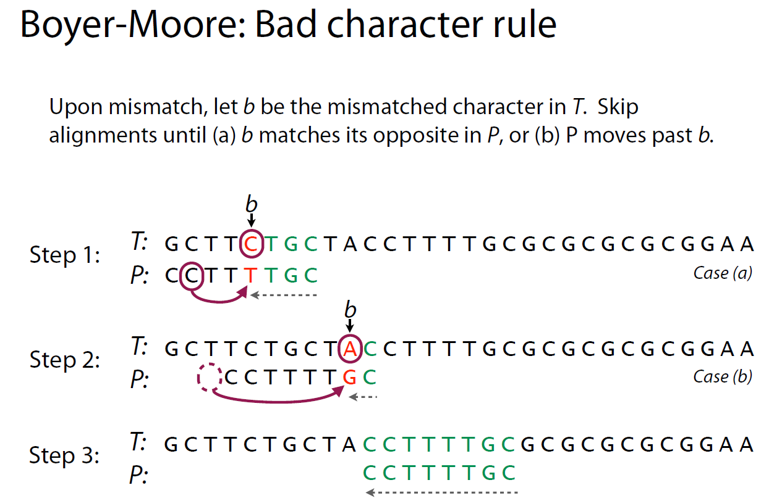

Slide 12
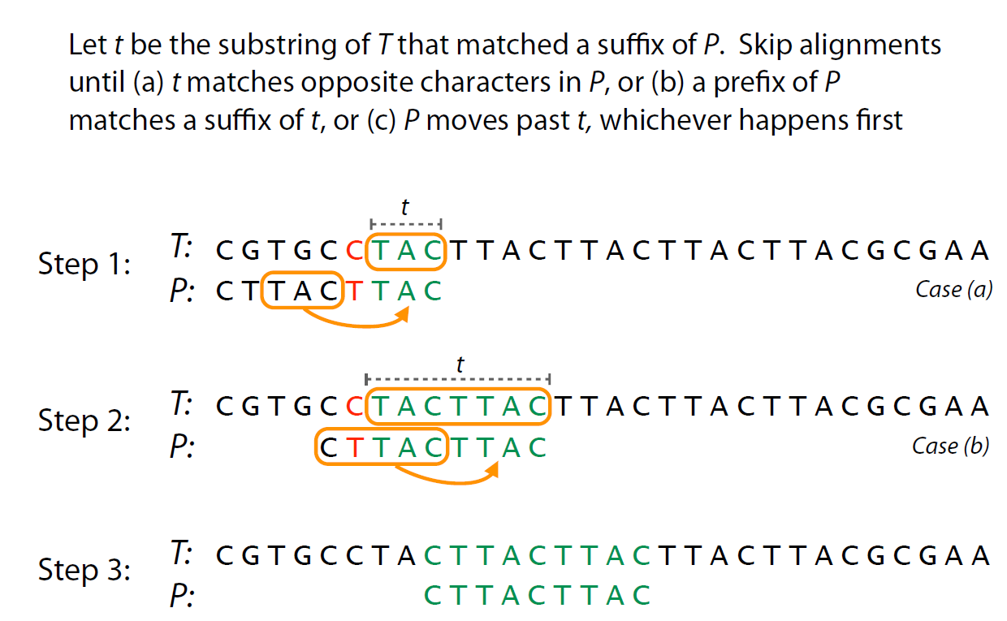
Good Character Suffix

Slide 13
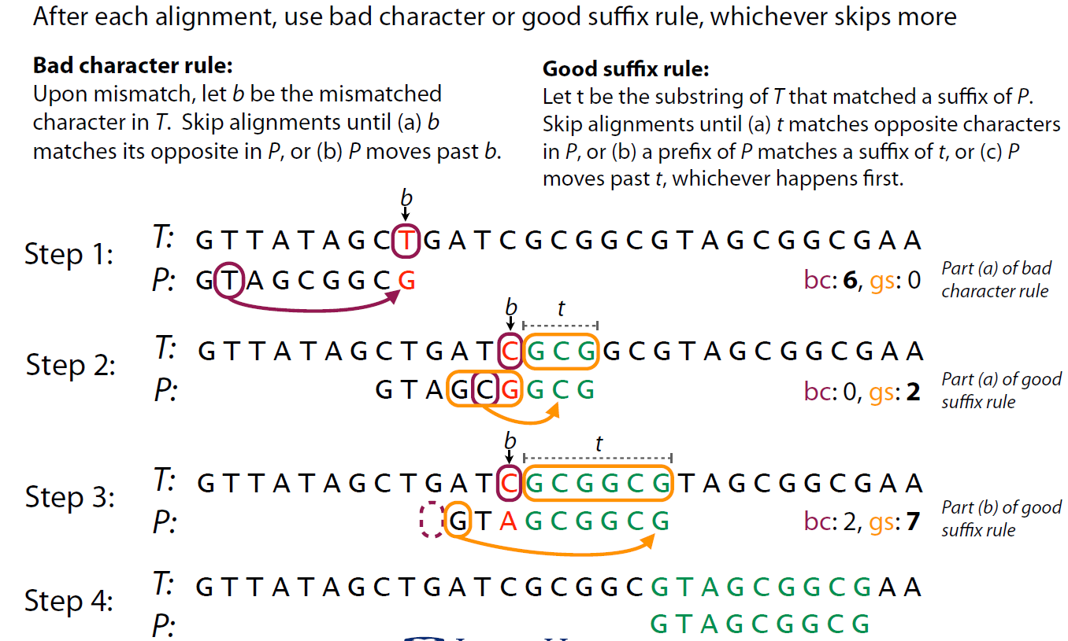

Slide 14
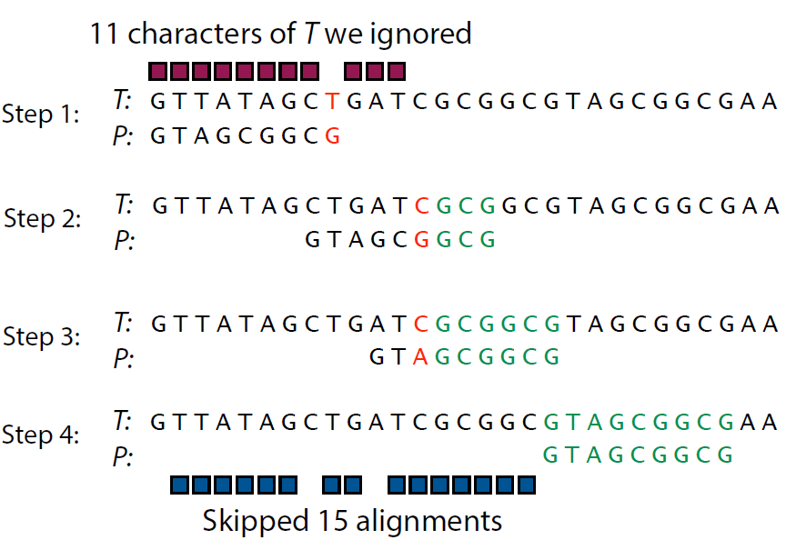
In contrast to Naïve Algorithm we never misses a single alignment or position.

Slide 15
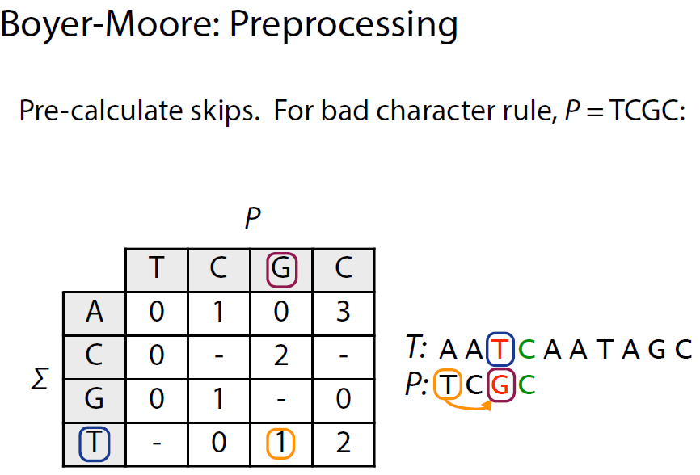
Here 1 indicates the number of skipped alignment.

Slide 16
Code and Tests
Compared Brute Force and Boyer Moore algorithms
We used an implementation published online and our own brute force implementation.
We have used python script to automate the generation of test files i.e. the text from which pattern should be searched.
Then we have used MongoDB to store the generated files.
We then wrote a test program to fetch the data from MongoDB and call the Boyer Moore API.

Slide 17
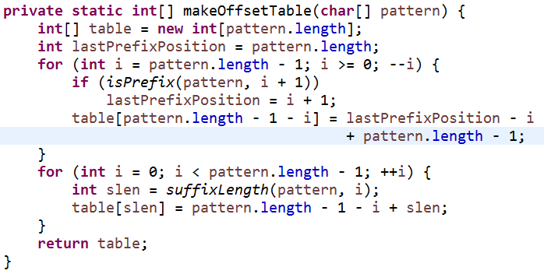
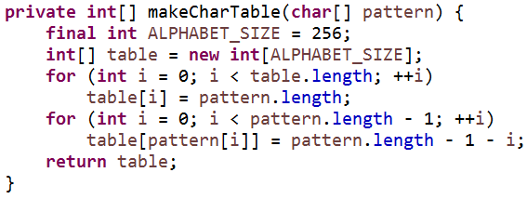
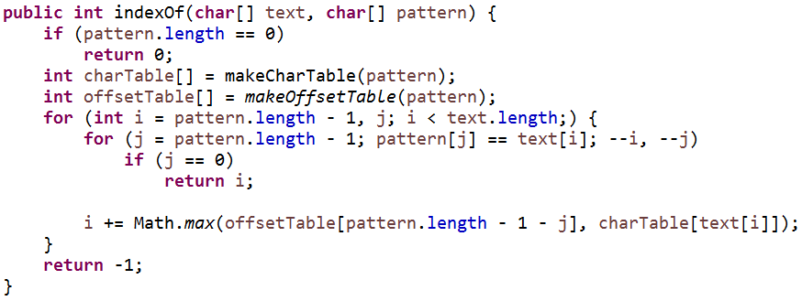
Boyer Moore Pseudo Code

Slide 18
Complexities
 | Time* | Space
Naive | Ω(TP) | O(T+P)
Boyer-Moore | Ω(T/P) | O(T+P+Σ)
T = Size of the Source text
P = Size of the Pattern text
Σ=Size of Alphabet
Σ = {a,b, …z}
Σ = {0,1}
* If source string does not contain pattern

Slide 19
Boyer Moore Average Case Time Complexity
The complexity is best when the letters in the pattern don’t match the letters in the text very often. Since this is generally the case, the average running time ends up being approximately equivalent to the best case.
O(N/M)
(length of text over length of pattern)

Slide 20
Boyer Moore Worst Case Analysis
Assume P consists of n copies of a single char and T consists of m copies of the same char:
T: aaaaaaaaaaaaaaaaaaaaaaaaa
P: haaaaa
or
T: aaaaaaaaaaaaaaaaaaaaaaaaa
P: aaaaaa
Boyer Moore Algorithm runs in O(mn) when finding all the matches

Slide 21
Performance: Boyer-Moore Algorithm
Text Size | Run Time
50015 | 2
100015 | 4
1500015 | 6
2000015 | 8
3500015 | 10
4500015 | 13
5500015 | 16
7000015 | 18
10000015 | 28
11000015 | 30
12000015 | 33
13000015 | 35
15000015 | 45

Slide 22
Boyer Moore Space Complexity

Slide 23
Performance: Naive Algorithm
Text Size | Run Time
50015 | 4
100015 | 5
1500015 | 9
2000015 | 11
3500015 | 17
4500015 | 22
5500015 | 31
7000015 | 34
10000015 | 45
11000015 | 55
12000015 | 57
13000015 | 60
15000015 | 63

Slide 24
Performance Comparison-Time

Slide 25
Applications
It is the standard benchmark for practical string search literature
The various applications of Boyer-Moore are:
Word processors and text editors
Intrusion detection system
Detecting Plagiarism
Information security
Bioinformatics
Pattern recognition

Slide 26
Conclusion
The Boyer-Moore string search method employs the ideology of performing precomputation rather than recomputation.
B-M is a String Searching Algorithm.
The algorithm preprocesses the pattern string that is being searched for, but not the string being searched in, which is T.
This algorithm’s execution time can be sub-linear, as not every character of the string to be searched needs to be checked. (Best case)
Its worst case running time is linear;
Generally the algorithm gets faster as the target string(pattern) becomes larger.

Slide 27
Variants of Boyer Moore
Turbo Boyer-Moore takes more space but needs 2*N steps in the worst case instead of the original’s 3*N steps.
Boyer-Moore-Horspool uses less space (only requires the good suffix table) and has a simpler inner loop with less constant overhead per iteration. Its average performance is O(N) but it has a worst-case performance of O(M*N).
The Raita algorithm improves the performance of Boyer-Moore-Horspool algorithm. The searching pattern of particular sub-string in a given string is different from Boyer-Moore-Horspool algorithm. Pre-processing stage takes O(m) time where "m" is the length of pattern "P". Searching stage takes O(mn) time complexity where "n" is the length of text "T".

Slide 28
Thank You

